Slide 1

ABC CALL VOLUME TREND ANALYSIS
PRACHI SHINDE

Slide 2
Agenda
PROJECT DESCRIPTION
APPROACH
TECH-STACK USED
INSIGHTS
RESULTS
CONCLUSION

Slide 3

PROJECT DESCRIPTION

Slide 4
PROJECT DESCRIPTION
This project focuses on analyzing a 23-day inbound calling dataset to assess agent performance and customer experience.
CX teams play a vital role by analyzing feedback, managing programs, and leveraging tools like IVR and Predictive Analytics to enhance customer satisfaction.
The project highlights the importance of inbound support in attracting, engaging, and delighting customers to build loyalty.
As a Data Analyst, we received dataset with details about the incoming calls and queries and we are required to analyze the data and provide insights to those queries.
To do this, we will use Microsoft Excel for data pre-processing and EDA to get the required insights.

Slide 5

TECH STACK USED
Microsoft Excel 2016 – A spreadsheet editor software used mainly by professionals to enter data in table format, perform computations, plot graphs etc.

Slide 6
ASSUMPTIONS
An agent works for 6 days a week.
On average, each agent takes 4 unplanned leaves per month.
An agent's total working hours are 9 hours, out of which 1.5 hours are spent on lunch and snacks in the office.
On average, an agent spends 60% of their total actual working hours (i.e., 60% of 7.5 hours) on calls with customers/users.
The total number of days in a month is 30.

Slide 7



INSIGHTS
AND DATA PRE-PROCESSING

Slide 8
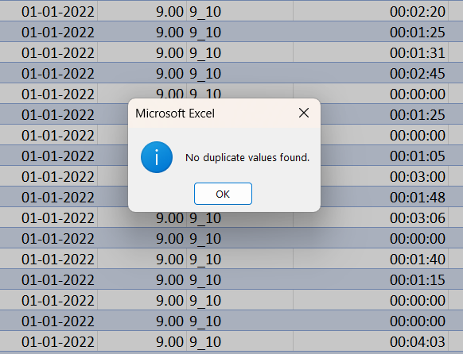
DATA CLEANING
FIRSTLY, WE CHECHED FOR THE DUPLICATES
USING EXCEL’S BUILT-IN FUCTION AND THERE WAS NO DUPLICATES FOUND.

Slide 9
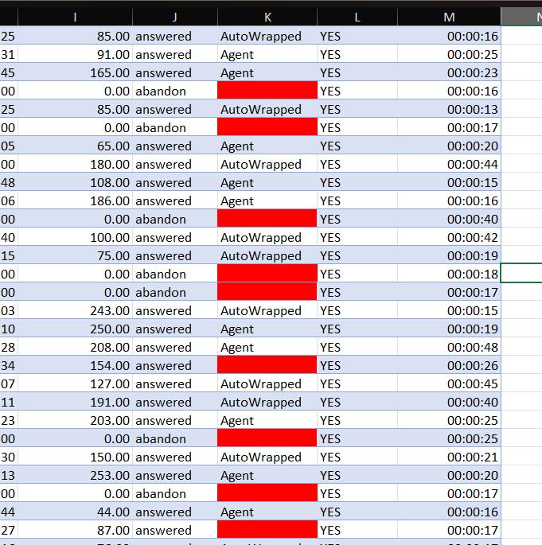
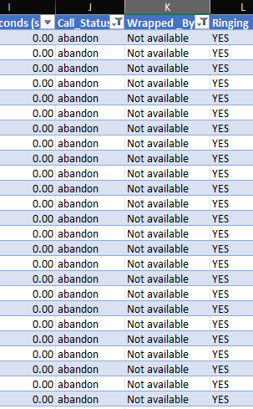
DATA CLEANING

Slide 10
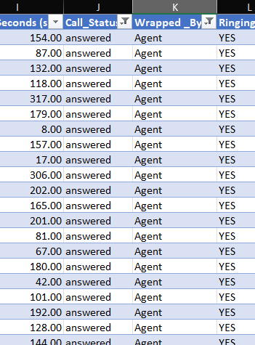
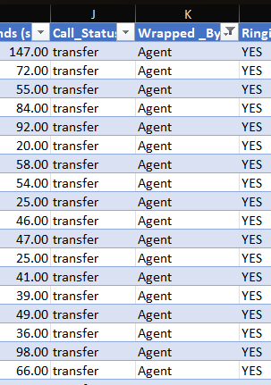
DATA CLEANING
WHERE WRAPPED BY WAS NULL WERE ANSWERED OR TRANSFERRED CALLS. SO REPLACED THEM WITH VALUE ‘AGENT’.
REST OF THE NULL VALUES WERE REPLACED BY VALUE ‘NOT AVAILABLE’ IN WRAPPED BY COLUMN.

Slide 11
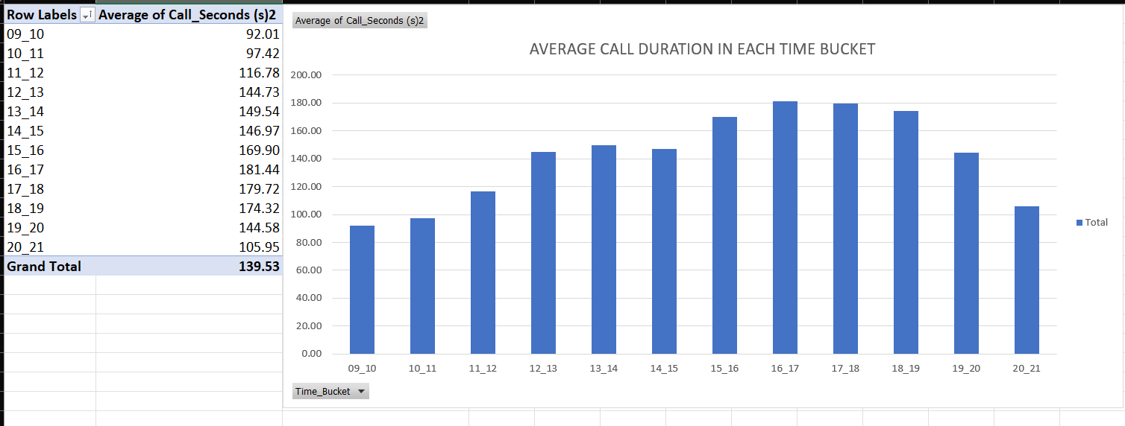
TASK 1: WHAT IS THE AVERAGE DURATION OF CALLS FOR EACH TIME BUCKET?

Slide 12
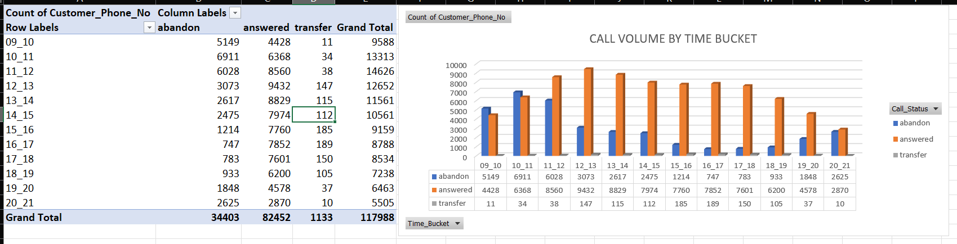
TASK 2: CAN YOU CREATE A CHART OR GRAPH THAT SHOWS THE NUMBER OF CALLS RECEIVED IN EACH TIME BUCKET?

Slide 13
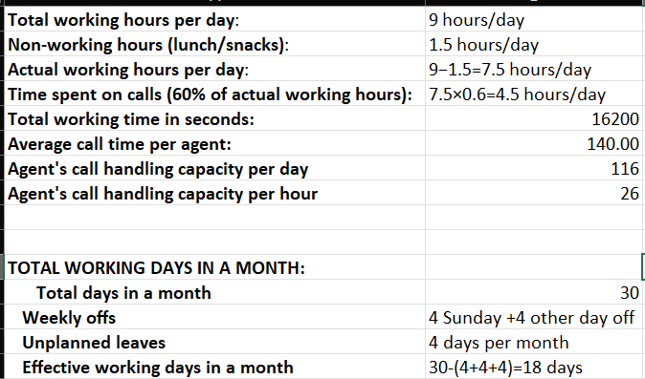
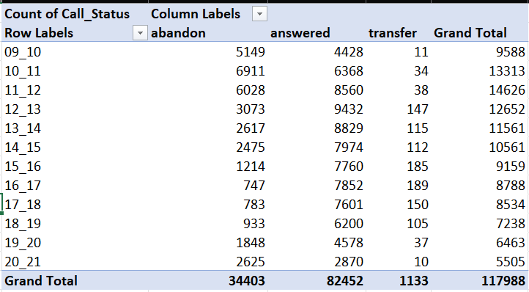
TASK 3: WHAT IS THE MINIMUM NUMBER OF AGENTS REQUIRED IN EACH TIME BUCKET TO REDUCE THE ABANDON RATE TO 10%?

Slide 14
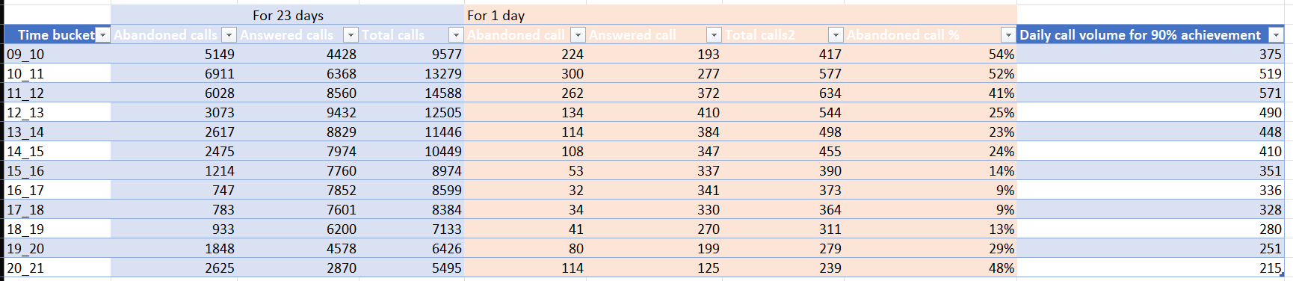
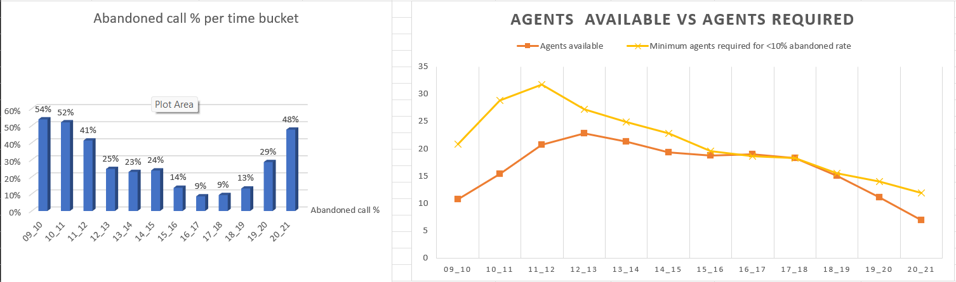

Slide 15
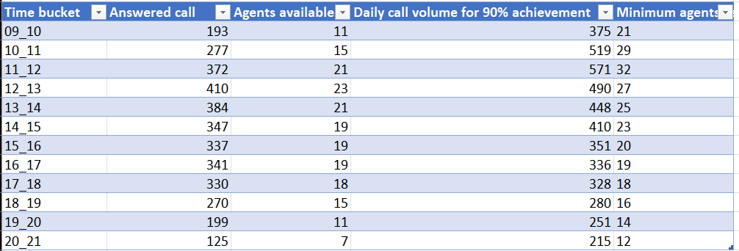

Slide 16
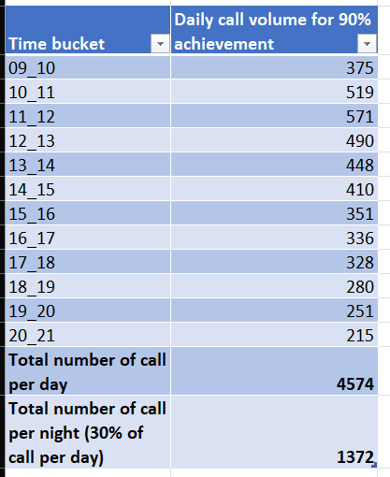
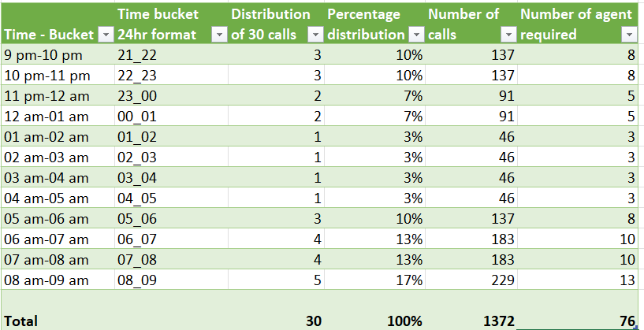
TASK4: PROPOSE A MANPOWER PLAN FOR EACH TIME BUCKET THROUGHOUT THE DAY, KEEPING THE MAXIMUM ABANDON RATE AT 10%.

Slide 17
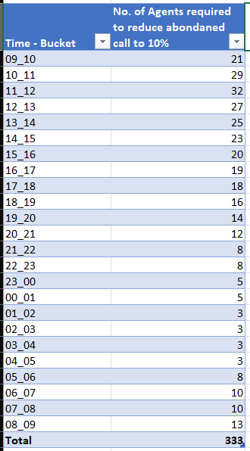
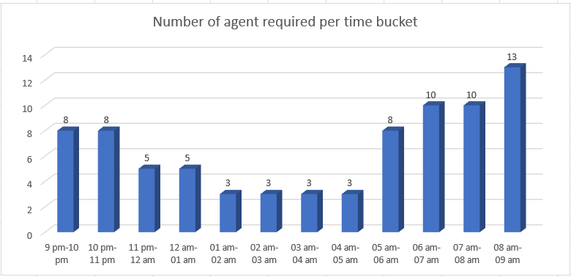
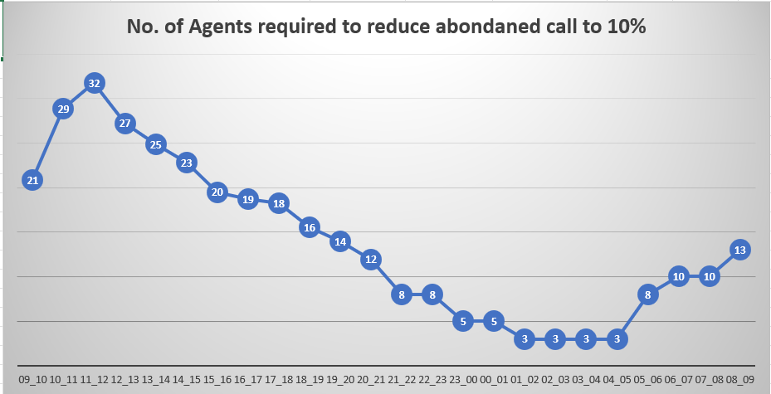

Slide 18

RESULTS

Slide 19
RESULT
An average time duration of a call is 140 seconds.
An agent on an average can handle 116 calls per day.
Consistent average call durations across all time buckets suggest stable operations, uniform service quality, efficient call handling, consistent customer behaviour patterns.
The maximum number of agents required is in the morning hours from 9am to 2pm, and the least number of agents required is at night hours from 11pm to 5am.
At present, no agents are available during the night shifts, therefore the company should hire more agents for night shifts or consider changing the shifts of some agents.

Slide 20


CONCLUSION
This project has aided me in understanding the importance of data analytics in customer experience analysis by providing valuable insights necessary for the data driven decision making.
Through this project, I gained insights into several aspects including call abandonment rates, call duration distribution, call volume, agent allocation and strategies for devising a workforce plan aimed at reducing abandoned calls.

Slide 21

THANK YOU
HYPERLINK TO EXCEL SHEET:
https://docs.google.com/spreadsheets/d/12U0kQzoSNBY8Tv9a5L9nxfHX_4_KhSaG/edit?usp=drive_link&ouid=114522139830880122868&rtpof=true&sd=true
HYPERLINK TO LOOM VIDEO FILES:

